Slide 1
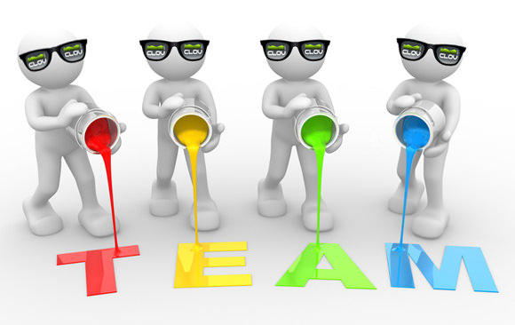
Project name: Tennis
Purpose:
Development of C#-based games optional
Developing skills in teamwork

Slide 2
Team name: Benning
Team members:
Iskra Nikolova
Lyubomir Mladenov
Adrian Yordanov
Alexander Kolarov
Lukas Kovalik
Aleksandar Garov

Slide 3

Contribution of team members:
Development of game: whole team
Concept about the game: Lyubomir Mladenov
Functionality: Aleksandar Garov and Alexander Kolarov
Formatting Aids: Adrian Yordanov
Design and layout: Iskra Nikolova and Lukas Kovalik

